Slide 1
Statistical Testing
Patrick Mathias & Brody Foy
Lab Medicine Core

Slide 2
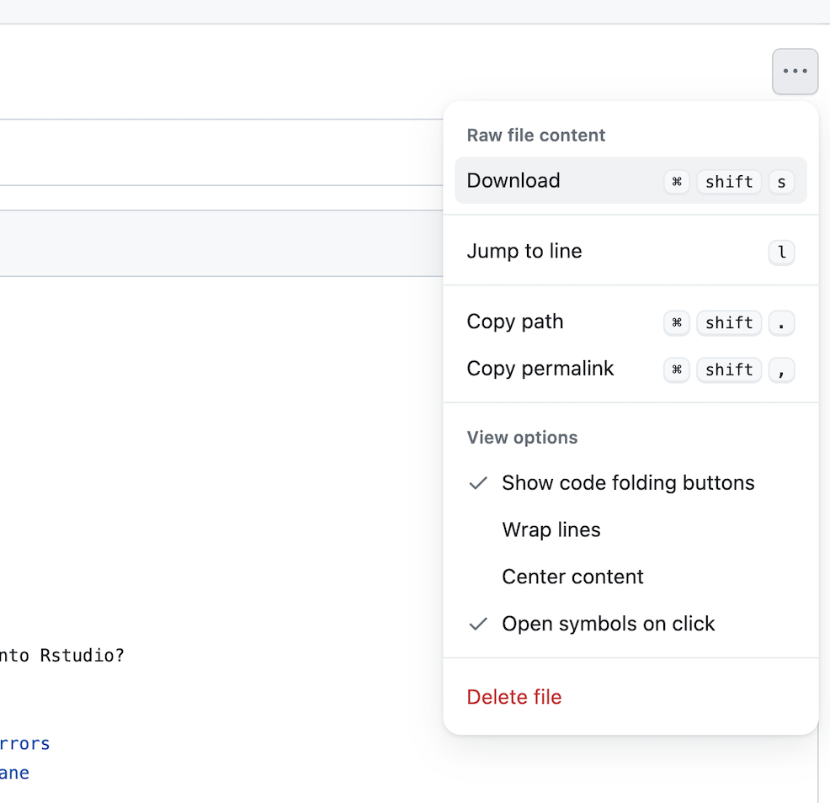
Lesson Prep
Locate the “06 – Stats” qmd file on the course website.
Navigate to the file and use the menu on the top right to download.
Upload to your core folder on the RStudio server

Slide 3
Lesson Goals
List required assumptions for using a Student’s t-test or a chi-squared test to answer questions
Identify common scenarios for which t-tests and chi-squared tests are appropriate
Lesson Objectives
Describe the common syntax for statistics functions available in the infer package
Perform 1 and 2 sample t tests using the infer package
Apply a chi-squared test to determine whether differences in event rates are statistically significant
Notes:
In this first session our goal is to develop some familiarity with the R programming language.
We will also discuss the important role of reproducible data analysis and how R can help us with this.

Slide 4
Your Turn #1
In your console, install the infer package using the following: install.packages(“infer”)
Open “06 – Stats.qmd”
Run the Setup Code Chunk section
Sticky up when done

Slide 5
Statistical tests
Notes:
Once we know how to do basic manipulations of a dataset, we can use this to run common statistical tests.

Slide 6
Statistical tests
We are often interested in whether observed values are meaningfully different either between groups, or from a fixed value. To do this we use statistical tests.
There are a wide variety of tests, but most operate in the same way.
1) You assume the shape (“distribution”) of the data if there is no effect – this is called the null hypothesis 2) Assuming the null hypothesis is true, you estimate the probability of seeing an effect as big as what your data shows by random chance.

Slide 7
Statistical tests
Imagine you have a six-sided die, and roll it 10 times, getting: 1, 5, 1, 1, 6, 3, 1, 1, 1, 2 That’s a lot of 1’s! Maybe the die is loaded… If we wanted to test whether the die is fair, we: 1) Assume the die is fair – that each outcome is equally likely
2) With this assumption, we estimate the probability of getting at least 6x 1’s from 10 rolls.

Slide 8
Statistical tests
From a fair die, the probability of rolling at least 6x 1’s in 10 throws is 0.24% (1 in 400). That’s pretty unlikely. This means our initial assumption (‘the die is fair’) is probably wrong!
The p-value from a statistical test is the probability of a result as extreme as the data occurring due to chance, given the null hypothesis. This is the 0.24% above.
Often we use the (somewhat arbitrary) threshold of p < 0.05 (5%).
Note, the p-value is NOT the probability our hypothesis is correct.

Slide 9
Statistical tests
When analyzing data, there are two questions we are often interested in:
1) Does a mean differ between two groups?
2) Does an event rate differ between two groups?
For most datasets these questions can be evaluated with 1) a t-test, and 2) a chi-squared test

Slide 10
Student’s t-test
Notes:
Once we know how to do basic manipulations of a dataset, we can use this to run common statistical tests.

Slide 11
Student’s t-test
To test differences in means, we often use a t-test. This test assumes:
1) The data points are independent
2) The data are normally distributed (bell-curve shaped)
3) The variance of the two groups is similar
There are two types of t-test:
1-sample: Test whether a mean differs from a given value
2-sample: Test whether two groups have different means

Slide 12
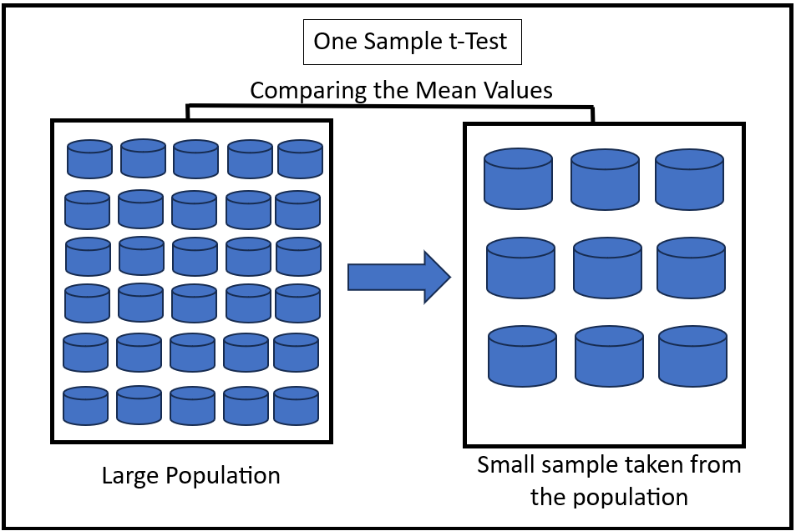
1-sample t-test
https://en.wikipedia.org/wiki/Student%27s_t-test

Slide 13
1-sample t-test
If we wanted to test whether total cholesterol levels were different from the US adult average (~190ng/mL), we’d use a 1-sample t-test:
Filter down to the given test and limit to outpatients
Run the t-test
chol_subset <- filter(chem, test == ‘cholesterol’, pat_type == ‘outpatient’)

Slide 14
1-sample t-test
If we wanted to test whether total cholesterol levels were different from the US adult average (~190ng/mL), we’d use a 1-sample t-test:
Filter down to the given test and limit to outpatients
Run the t-test
dataframe
variable
presumed value
t_test(chol_subset, response = value, mu = 190)

Slide 15
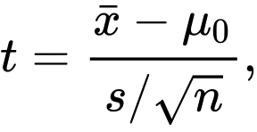
1-sample t-test
chol_subset <- filter(chem, test == ‘cholesterol’, pat_type == ‘outpatient’)
t_test(chol_subset, response = value, mu = 190)
p-value
t-statistic

Slide 16
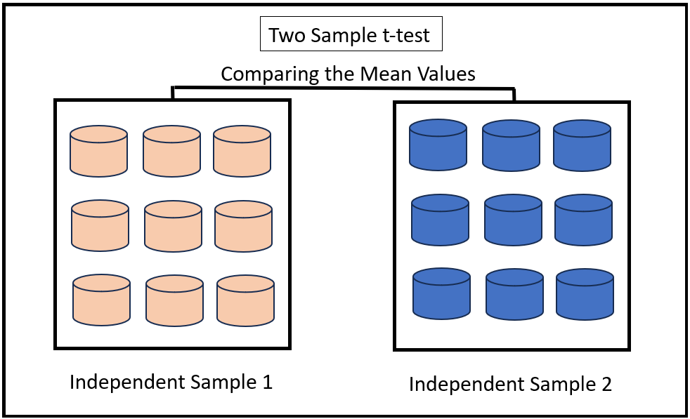
2-sample t-test
https://en.wikipedia.org/wiki/Student%27s_t-test

Slide 17
2-sample t-test
If we wanted to know whether women had lower iron levels than men, the steps would be:
Filter down to the given test and cohort
Run a 2-sided t-test
iron_subset <- filter(chem, test == ‘iron’, pat_type == ‘outpatient’)

Slide 18
2-sample t-test
If we wanted to know whether women had lower iron levels than men, the steps would be:
Filter down to the given test and cohort
Run a 2-sided t-test
outcome variable
dataframe
group value
t_test(iron_subset, response = value, explanatory = gender,
order = c(“Female”, “Male”)
female values are the reference
For this difference in means calculation, subtract male values from female values

Slide 19
2-sample t-test
iron_subset <- filter(chem, test == ‘iron’, pat_type == ‘outpatient’)
t_test(iron_subset, response = value, explanatory = gender,
order = c(“Female”, “Male”)

Slide 20
Your Turn #1
Open “06 – Stats.qmd”
Work through the T-test exercises section
Sticky up when done

Slide 21
Chi-squared test
Notes:
Once we know how to do basic manipulations of a dataset, we can use this to run common statistical tests.

Slide 22
Chi-squared test
To test for differences in event rates, we often use a chi-squared test. This test assumes:
1) The data points are independent
2) We expect at least 5 occurrences of each event for each sub-group
The most common type of chi-squared tests whether event rates are similar for multiple groups. There are other variants for different scenarios.

Slide 23
Chi-squared test
Lets say we want to know if two clinics order a test at the same rate. We have the following data:
To evaluate this, we need to know what the average rate of ordering is: avg rate = (51 + 81)/(103 + 209 + 51 + 81) = 29.7%
 | Test not ordered | Test ordered
Clinic 1 | 103 | 51
Clinic 2 | 209 | 81

Slide 24
Chi-squared test
If on average the test is ordered for 29.7% of visits. Then for clinic 1, which has 154 total visits we’d expect 154*0.703: 108.2 tests not ordered, and 154*0.297: 45.8 tests ordered Clinical 2 has 290 total visits, so we’d expect 86.1 tests ordered, 203.9 tests not ordered
A chi-squared test checks whether this table is meaningfully different to the observed table
 | Test not ordered (Expected) | Test ordered (Expected)
Clinic 1 | 108.2 | 45.8
Clinic 2 | 203.9 | 86.1

Slide 25
Chi-squared test
To run chi-squared tests in R, we have three steps
Filter down to the given test and groups
Generate the binary outcome variable
Run the test
To illustrate this, lets check whether male + female outpatients have different rates of low iron (<31)

Slide 26
Chi-squared test
To run chi-squared tests in R, we have three steps
Filter down to the given test and groups
Generate the binary outcome variable
Run the test
iron_subset <- filter(chem, test == ‘iron’, pat_type == ‘outpatient’)

Slide 27
Chi-squared test
To run chi-squared tests in R, we have three steps
Filter down to the given test and groups
Generate the binary outcome variable
Run the test
iron_subset <- iron_subset |>
mutate(iron_binary = (value < 32))

Slide 28
Chi-squared test
To run chi-squared tests in R, we have three steps
Filter down to the given test and groups
Generate the binary outcome variable
Run the test
outcome variable
dataframe
group value
chisq_test(iron_subset, iron_binary ~ gender)

Slide 29
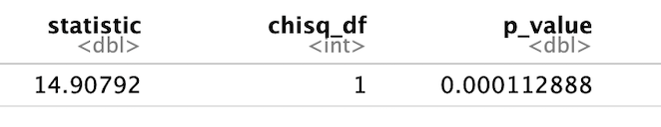
Chi-squared test
iron_subset <- filter(chem, test == ‘iron’, pat_type == ‘outpatient’)
iron_subset <- iron_subset |> mutate(iron_binary = (value < 32))
chisq_test(iron_subset, iron_binary ~ gender)

Slide 30
Your Turn #2
Open “06 – Stats.qmd”
Work through the chi-squared section, including exercises
Sticky up when done

Slide 31
What Else?
Notes:
In this last part of this session, I want to show a few additional things you can do with ggplot, without going into much detail.

Slide 32
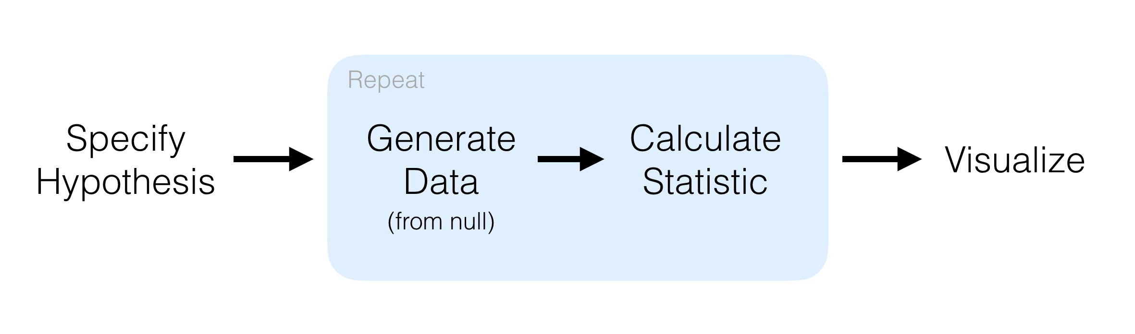
The infer package is built to work with tidy data
In this lesson we used the infer package to limit data manipulation
We used special helper functions for specific tests but the package uses a broader framework with 4 core functions to do a large range of tests:
specify() allows you to specify the variable, or relationship between variables, that you’re interested in.
hypothesize() allows you to declare the null hypothesis.
generate() allows you to generate data reflecting the null hypothesis.
calculate() allows you to calculate a distribution of statistics from the generated data to form the null distribution.
Learn more by typing vignette(“infer”) into R!

Slide 33
Base R includes a wide variety of statistical tests
R was derived from the S language - both are intended to support statistics
Without installing separate packages there are dozens of helpful stat functions
Major drawback is that many functions do not assume your dataframe is tidy: many assume that two observations are in two columns rather than rows
t.test(column1 ~ column2, data = dataframe)

Slide 34

Resources for you in the future
R for Data Science, 2nd edition: https://r4ds.hadley.nz/
Conference workshops (beyond the basics):
Association for Pathology Informatics
Mass Spectrometry and Advances in the Clinical Lab
Informatics faculty are here to help! Find us on Teams!
Please fill out post-course survey:
https://bit.ly/4eqVyFp

